Slide 1
Process management in android
Shrey Verma | 190101083
Mayank Chandak | 190101052
Karan Raj Sharma | 190101043

Slide 2
Process and Application Fundamentals in Android
Android App is a software designed to run on an Android device.
They can be written using Kotlin, Java, and C++ languages.
By default, all components of the same application run in the same process

Slide 3
APP COMPONENTS IN ANDROID
Component​ | Function​
Activities​ | the entry point for interacting with the user.​
Services​ | A general-purpose entry point for keeping an app running in the background​
Broadcast receivers​ | A well-defined entry point that enables the system to deliver events to the app outside of a regular user flow​
Content providers​ | manages a shared set of app data that you can store on any persistent storage location that your app can access​

Slide 4
Processes and Application Lifecycle
In most cases, every Android application runs in its own Linux process.
This process is created for the application when some of its code needs to be run, and will remain running until it is no longer needed, and the system needs to reclaim its memory for use by other applications.
It is important to understand how different application components impact the lifetime of the application's process.

Slide 5
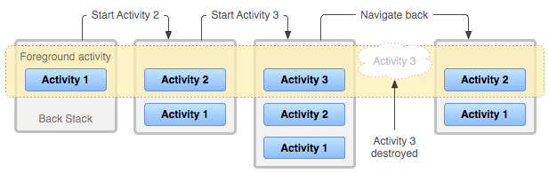
Activity stack
Activities in the system are managed as Activity Stacks.
When a new activity is started, it is usually placed on the top of the current stack and becomes the running activity.
The previous activity always remains below it in the stack and will not come to the foreground again until the new activity exits.

Slide 6
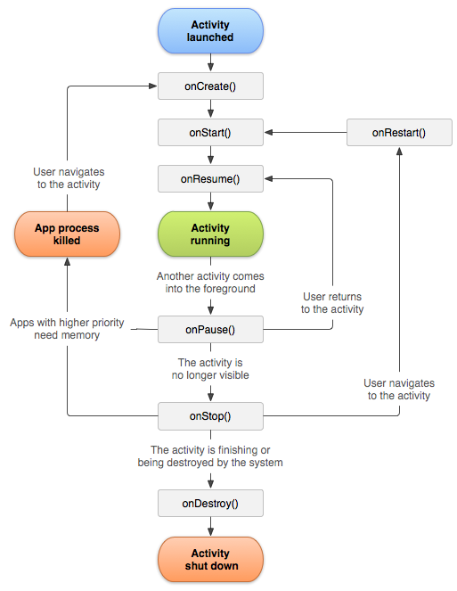
Activity Life Cycle

Slide 7
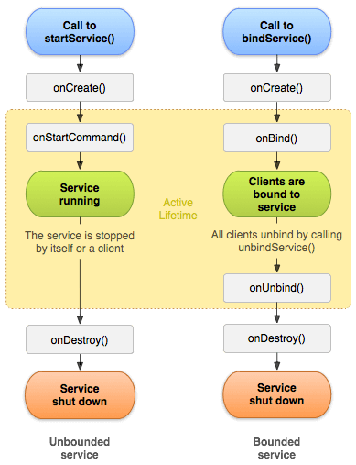
Service life cycle

Slide 8
Process importance hierarchy
To determine which processes should be killed when low on memory, Android places each process into an "importance hierarchy" based on the components running in them and the state of those components.
These process types are (in order of importance):
Foreground Process
Visible Process
Service Process
Cached Process

Slide 9
Types of processes
Type​ | Definition​
Foreground Process | A foreground process is a process with which the user is currently interacting and using it.
Visible Process | This process when the activity is visible to the user. The user does not directly interact with this process.
Service Process | This process isn’t tied to any app that’s visible on your screen. However, it’s doing something in the background that the user cares about.
Cached Process​ | These are the processes which are not currently needed. Multiple cached processes always available for more efficient switching between applications.

Slide 10
When are they killed?
Type​ | Condition​
Foreground Process | There will only ever be a few such processes in the system, and these will only be killed as a last resort if memory is so low that not even these processes can continue to run.
Visible Process | These processes are considered important for UI since they are visible and will not be killed unless doing so is required to keep all foreground processes running.
Service Process | The system will always keep such processes running unless there is not enough memory to retain all foreground and visible processes. Services that have been running for a long time may be demoted in importance to allow their process to drop to the cached list so that they don’t keep on taking up resources for long time.
Cached Process​ | These are not currently needed, so the system is free to kill it as desired when resources like memory are needed elsewhere. A well running system will have multiple cached processes always available and regularly kill the oldest ones as needed.

Slide 11
Threads
Each application in android is composed of multiple threads of execution running concurrently.
Every thread has a priority.
When a Java Virtual Machine starts up, there is usually a single non-daemon thread. The new thread has its priority initially set equal to the priority of the creating thread and is a daemon thread if and only if the creating thread is a daemon.
The Java Virtual Machine continues to execute threads until either of the following occurs:
The exit method of class Runtime is called, and the security manager has permitted the exit operation.
All threads that are not daemon threads have died, either by returning from the call to the run method or by throwing an exception that propagates beyond the run method.

Slide 12
Inter Process communication
There are two ways processes communicate with one another:
Intents: An intent is used to perform an action on the screen. It is mostly used to start an activity, send a broadcast receiver, start services and send messages between two activities.
Android Interface Definition Language (AIDL): It allows us to define the programming interface that both the client and service agree upon in order to communicate with each other using inter process communication (IPC).

Slide 13
Deadlock Handling
Deadlock is a common problem in multiprocessing systems. It occurs when the following 4 conditions hold simultaneously:
Mutual Exclusion
Hold And Wait
No Preemption
Circular Wait
And there are 3 ways in which most OS deal with deadlock:
Prevent or Avoid
Detect and recover
Ignore the problem
Android OS detects that a deadlock has occurred and tries to recover from it.

Slide 14
DEADLOCK Detection algorithm and recovery
In the deadlock detection algorithm, we try to fulfill the requests one by one where the requested resources can be made available from the available ones. We do this for every process for whom it is possible. If we are able to fulfill all the requests there is no deadlock, otherwise the system is in a deadlocked state.
For recovery, we need to roll back to some safe state and restart process from that state.

Slide 15
CPU SCHEDULING
Android's Scheduling Policy is based on Linux.
SCHED_FIFO | SCHED_RR | SCHED_OTHER
FCFS Scheduling Policy | Round Robin Scheduling Policy | Completely Fair Scheduling Policy
For real time processes (e.g., data transmission processes related to hardware) |  | For ordinary processes

Slide 16
CFS - COMPLETELY FAIR SCHEDULING
By Ingo Molnar
Linux Scheduler since 2.6.23
Handles I/O and CPU bound processes elegantly
Idea
Divide processor time equally among the processes
Based on Ideal Fairness
If there are n processes waiting to be scheduled, each process will get (100/n)% of the CPU time.

Slide 17
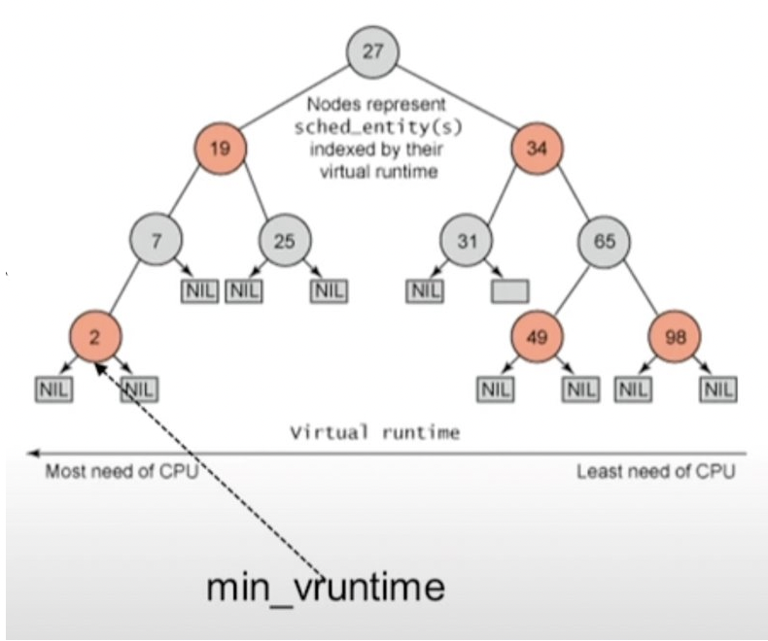
Completely fair scheduling
Each process has a "nice" value and a variable "vruntime" associated with it.
Higher priority = lower "nice" value
At every context switch or scheduling point, if process has run for t ms,
vruntime += t * (weight due to nice value)
These processes are arranged in a red black tree data structure.
Processes on the left have "vruntime" less than processes on the right.
So, the leftmost process has the least vruntime. This process is cached onto a different variable "min_vruntime". This process will be picked at context switch.

Slide 18
Nice values
The processes or threads can have different weights from –20 to 19.
Some constants defined in the Android source code (https://developer.android.com/reference/android/os/Process) are
THREAD_PRIORITY_LOWEST | 19
THREAD_PRIORITY_BACKGROUND | 10
THREAD_PRIORITY_DEFAULT | 0
THREAD_PRIORITY_FOREGROUND | -2
THREAD_PRIORITY_DISPLAY | -4
THREAD_PRIORITY_URGENT_DISPLAY | -8
THREAD_PRIORITY_VIDEO | -10
THREAD_PRIORITY_AUDIO | -16
THREAD_PRIORITY_URGENT_AUDIO | -19

Slide 19
Control groups
Practically, the Scheduling is not sufficient to ensure smooth experience for the user.
To further limit the impact of the background processes on the foreground processes,
Android also uses control groups.
Control groups or cgroups is a Linux kernel feature that organizes processes into hierarchical groups whose usage of resources can be limited and monitored.

Slide 20
Priorities of different cgroups
In background cgroups, the threads can use only 1 percent of CPU so that the foreground jobs are completed without delay.
Different cgroups and their priorities in Linux
THREAD_GROUP_DEFAULT | -1
THREAD_GROUP_BG_NONINTERACTIVE | 0
THREAD_GROUP_FOREGROUND | 1
THREAD_GROUP_SYSTEM | 2
THREAD_GROUP_AUDIO_APP | 3
THREAD_GROUP_AUDIO_SYS | 4
THREAD_GROUP_TOP_APP | 5
THREAD_GROUP_RT_APP | 6
THREAD_GROUP_RESTRICTED | 7

Slide 21
SCHEDTUNE AND CPUSET
The cgroup level is adjusted in Android using two subsystems schedtune and cpuset.
SCHEDTUNE
It is used by Android since 7.1 to allocate CPU resources
It is mainly used
To control process scheduling
Select CPU
Trigger boost
CPUSET
It is used to bind processes to the specified CPU and memory nodes.

Slide 22


Mayank Chandak | mchandak@iitg.ac.in | 190101052
Shrey Verma | v.shrey@iitg.ac.in | 190101083
Karan Raj Sharma | karan.raj@iitg.ac.in | 190101043

